Slide 1
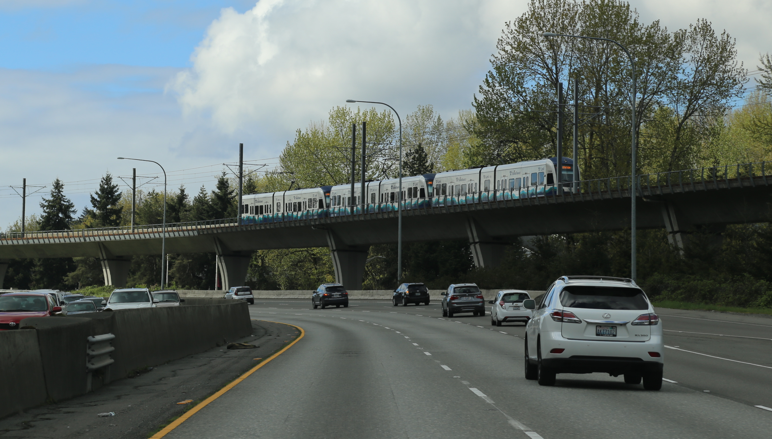

Puget Sound Regional Household Travel Survey Program
2022 October 12
Megan Grzybowski // Data Intern
Travel Survey Analysis Team
Notes:
Introductions
There were many PSRC staff members that contributed to this work:
Especially Brian Lee, Suzanne Childress, Mary Richards, Christy Lam, Michael Jensen, and Eric Clute

Slide 2

Overview
Introduction to the
Household Travel Survey program
Trends in Home Delivery
Deliveries by:
Household Income
Lifecycle Stage
Regional Growth Centers
2
Notes:
Then we’ll look at the overall trends in food, grocery, work/service, and package deliveries per households
Following that, we’ll dive into the changes seen in deliveries based off of:
household-level income
overall age groupings, or what we call “lifecycle stage” of the household, and
whether or not the delivery was made to a household located in a Regional Growth Center.

Slide 3
Puget Sound Travel Surveys
1961
1971
1988
1989-2002
1999
2006
2014-2015
2017 2019 2021
Webpage: https://www.psrc.org/household-travel-survey-program
3
Notes:
Puget Sound Travel Surveys go back to 1961 and have been taken incrementally over the years.
However, as we’re looking to be able to better understand travel behavior and make comparisons between the data we gather, so we’ve begun conducting smaller and more frequent travel surveys, starting with the 2017, 2019, and 2021 iterations.

Slide 4

2017-2021 Puget Sound Regional Household Travel Survey Program
Goal: The surveys seek to capture quality, regionally representative data for residents’ travel behavior on a typical weekday.
6-year program, 3 waves
2017, 2019, and 2021 completed
2021 analysis happening now
New 8-year program
2023 survey project started
Motivations
Frequent snapshots, ability to combine years
“Smoother” budgets and labor roles
Opportunities for add-ons
4
Notes:
Which does not include commercial travel, like freight (residents**)
Motivations:
There’s more rapid changes to growth in the area, so with more frequent snapshots we’ll be able to combine multiple years of data, similar to the American Community Survey process
From and operational view. Able to budget funds, allocate staff to the project with already pre-existing institutional knowledge, and able to offer jurisdictions to purchase additional data.

Slide 5
Macroeconomic context
2021 survey period:
April to June
Employment rising during 2021 survey, but still below March 2020 high mark
5
Source: WA Employment Security Department, Covered Employment (QCEW)
Notes:
Another thing I want to touch on that is part of the bigger picture as we talk about purchases of deliveries that I think is important is the Macroeconomic context
Although employment numbers are only one indicator of macroeconomic context, they are helpful in assessing economic status.
When people think of the COVID impacts, like you can see in April 2020, we like to think that our employment rates have rebounded and are back to what they used to be before COVID. Although they are continuing to rise, they still have yet to reach the pre-COVID levels that they were at previously. Our region is still experiencing those residual impacts from the pandemic.
Why this is important, is because the survey period for the 2021 survey was from April 2021-June 2021, so we were still seeing impacts during the time of the survey.

Slide 6
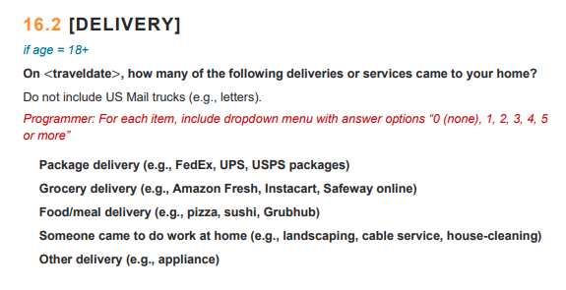
Household Travel Survey Questionnaire
6
Notes:
This is the question that was asked in the 2021 Household Travel Survey questionnaire in 2021.
As you can see, we distinguish between packages, grocery, food/meal, work/service, and other delivery, such as appliances. What we focused on for this analysis pertained to the top four. (animation)
We’ll reference these distinctions throughout our discussion today.
We also want to be mindful of the conclusions that we draw regarding how deliveries impact shopping trips made by households.
We looked into shopping trips, but there weren’t significant changes, and as shopping trips may reduce deliveries, we cannot confirm that causality, and due to the survey only capturing weekdays, it is difficult to tell whether weekend behaviors changed.
Before we hop into some of the other factors that may have influenced number of deliveries for households, we’ll look at the overall trends for each of these types of delivery

Slide 7
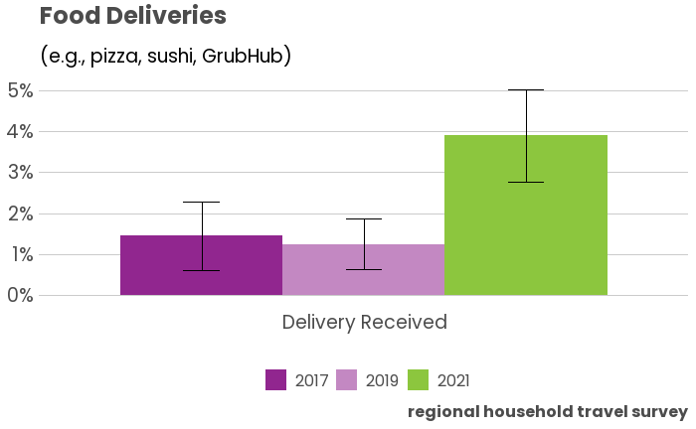
The share of households receiving a food or meal delivery
more than doubled to around 4% in 2021.
7
Notes:
We’ll start off with food deliveries – this pertains to items like pizza or sushi (prepared foods) or GrubHub type deliveries.
The share of households receiving a food delivery more than doubled to around 4% in 2021.
However, that share of households still accounts for a small share of households received food deliveries on an average weekday.
(animation) Additionally, I’d like to speak to these are estimates and there are variability in estimations.

Slide 8
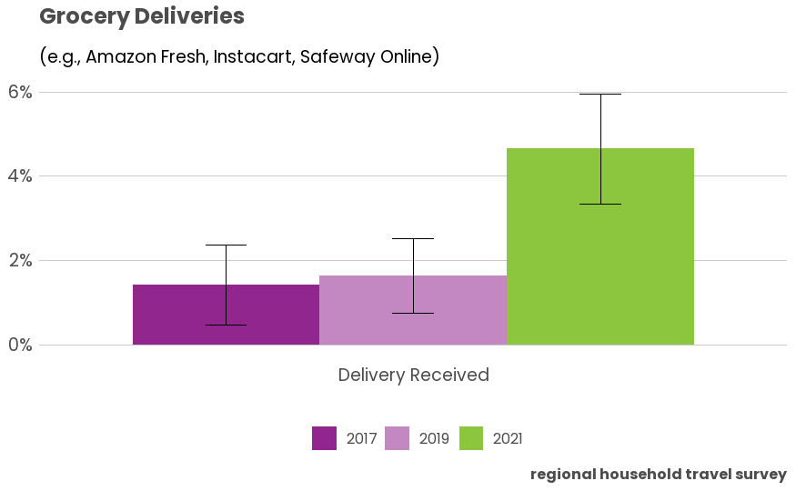
The share of households receiving a grocery delivery also more than doubled up to around 5% in 2021.
8
Notes:
Next we have Grocery Deliveries, that means ordering groceries on the internet and having them delivered to your home.
The share of households…
But again, you’ll notice that this is still a small percentage of households.

Slide 9
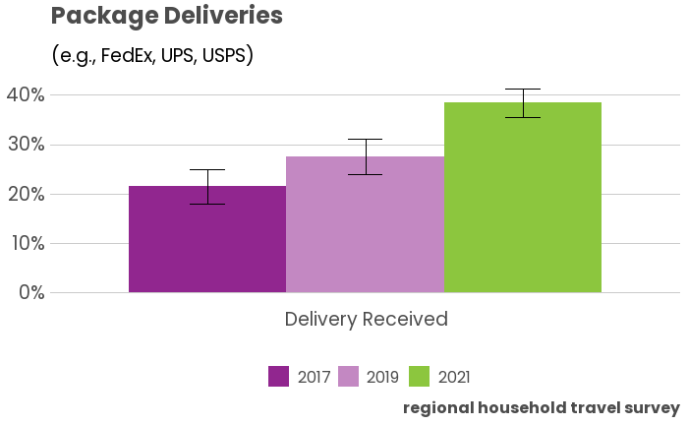
The share of households receiving a package delivery on average weekday went up to nearly 40% in 2021 from around 20% in 2017.
9
Notes:
Package deliveries denote items that are more general through FedEx, UPS, or USPS entities.
The share of households…
Though it looks like a linear progression, the increase from 2017-2019 was about 5%, and then from 2019-2021 around 10-12%, so the growth rate doubled.
This type of delivery represents the highest share of deliveries on an average weekday for households, which you’ll see in a cross comparison later.

Slide 10
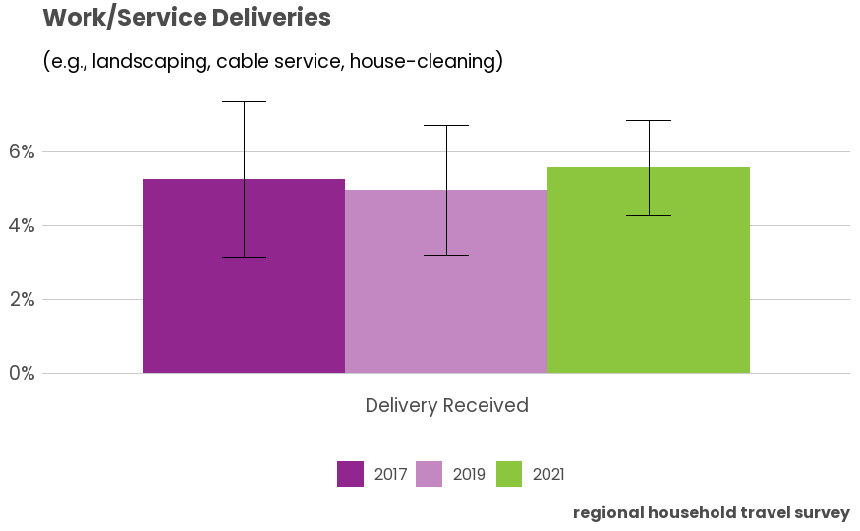
The share of households having work or service at the home stayed about the same, at around 5%.
10
Notes:
Work or Service deliveries pertain to people coming to your home to perform a service, like landscaping or house-cleaning.
The share of households…

Slide 11
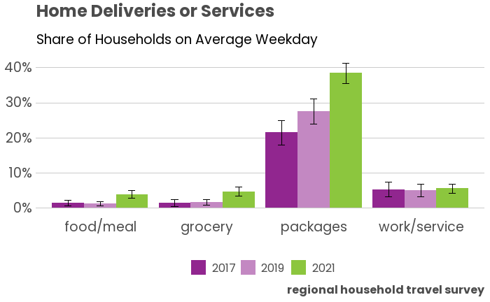
Food, grocery, and package home delivery increased from 2017 to 2021. Package delivery is only type that is more than 5% on an average weekday.
11
Notes:
This plot is just the combination of the plots that we just discussed, but with a fixed scale
Food, grocery, and package…
As we can see here, the average household receiving packages on a weekday in far higher than those receiving other types of deliveries.

Slide 12
Delivery Trends
Household Income
Lifecycle or Household Stage
Regional Growth Centers
12
Notes:
The trends we’ll look at will pertain to the relationship between food, grocery, work/service, and package deliveries per household, as they are influenced by household-level income, lifecycle or age grouping of household, and whether or not the delivery was made to a household located in a Regional Growth Center.

Slide 13
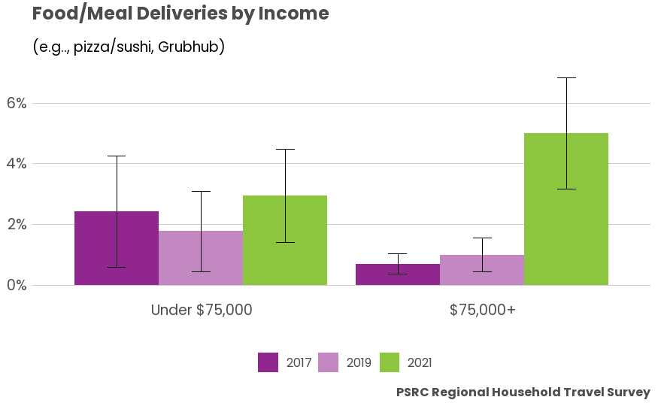
Deliveries and Household Income:
Higher income households were substantially more likely to get a food/meal delivery as compared to lower income households in 2021, but not previously.
13
Notes:
We’ll start with household income…
Other Analyses:
For grocery deliveries, there was less of a substantial significance between income brackets with about a 1% difference between the higher and lower-income groups. That being said, similar to food deliveries, the higher income households still remained more likely to get groceries delivered than their lower income counterparts.

Slide 14
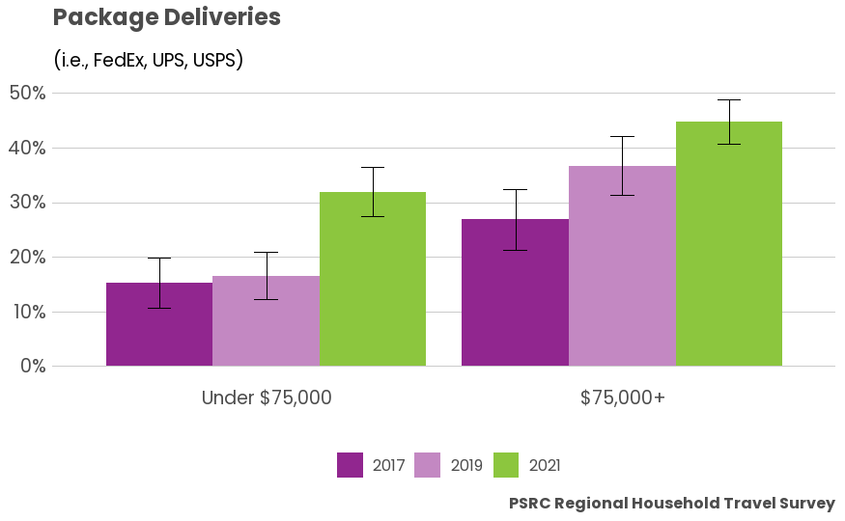
Deliveries and Household Income:
For package deliveries, lower income households had a significant spike in these type of deliveries.
14
Notes:
Work/service deliveries remained stable and similarly unchanged.

Slide 15
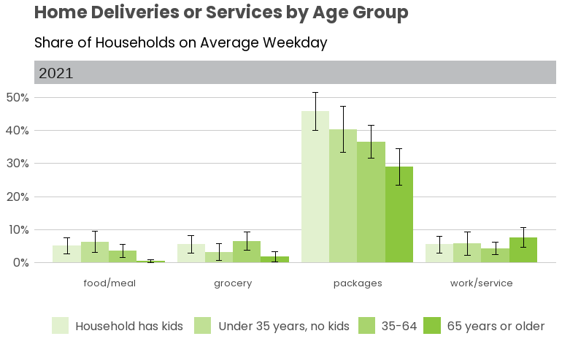
Deliveries and Lifecycle (2021 alone):
Households with children received the most packages in 2021, but the other home deliveries and services remained relatively stable.
15

Slide 16
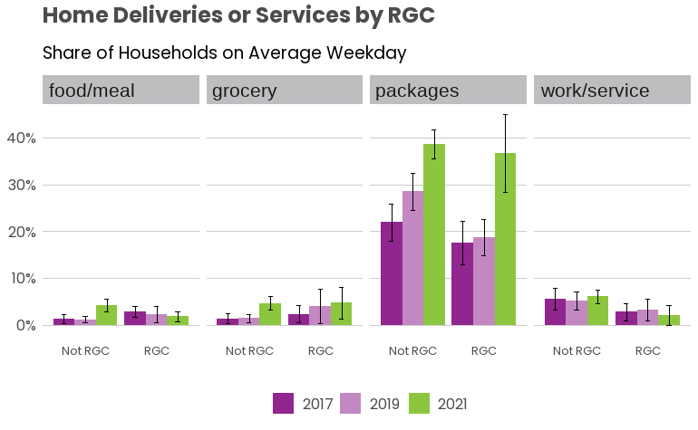
Deliveries and Regional Growth Centers:
Food and grocery deliveries in RGCs remained relatively stable, while the same deliveries outside of RGCs more than doubled to over 4%.
17
Notes:
Package deliveries increased significantly in RGC’s from 2017 and 2019 to 2021, but not as significantly for those not located in RGCs

Slide 17
Future Applications for Delivery Data
Academics and Modelling Generation: Carnegie Mellon University has been able to use the delivery data available through PSRC to analyze travel behavior and congestion on a typical weekday.
Opportunities to continue and support these efforts nationally.
18
Notes:
(Ask Brian about)

Slide 18

Thank you.
PSRC Household Travel Survey Program Webpage: https://www.psrc.org/household-travel-survey-program
Suzanne Childress Schildress@psrc.org
Brian Lee Blee@psrc.org
Megan Grzybowski Mgrzybowski@psrc.org
19

Slide 19
Workplaces
Increases in hybrid work and full-time work at home
63% of workers still working outside the home
Source: Puget Sound Regional Council, Household Travel Survey program
Notes:
Increases in hybrid work environment, telework full-time
63% of workers still working outside of the home; 37% work at home

Slide 20
Workplace Travel
Greater proportion of male workers worked outside the home than female workers
Source: Puget Sound Regional Council, Household Travel Survey program
Notes:
A greater proportion of male workers worked outside the home than female workers

Slide 21
Workplace Travel
Greater proportion of African American and Hispanic workers worked outside the home than regional average
Source: Puget Sound Regional Council, Household Travel Survey program
Notes:
Greater proportions of African American and Hispanic workers were working outside the home compared to the regional average

